Slide 1

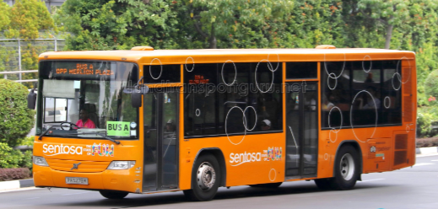

Capstone Project
Presented by: BDA09 Group05 - The Rising Seven
13 Jan 2022

Slide 2

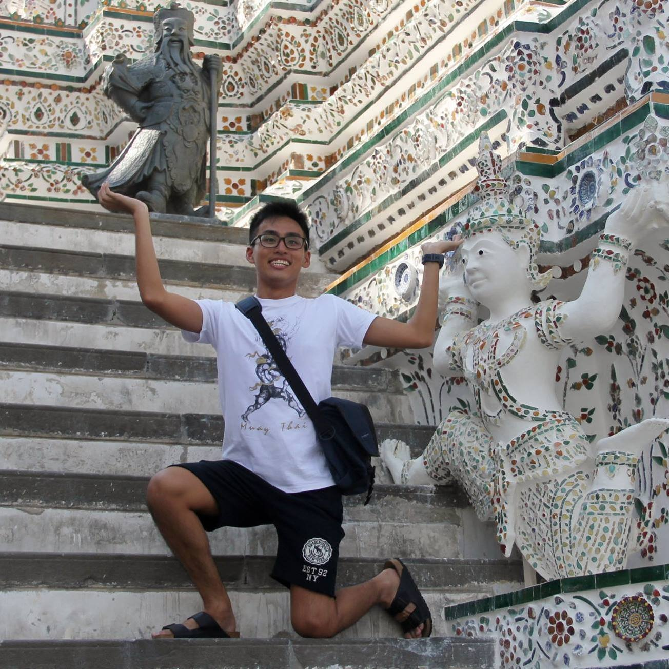


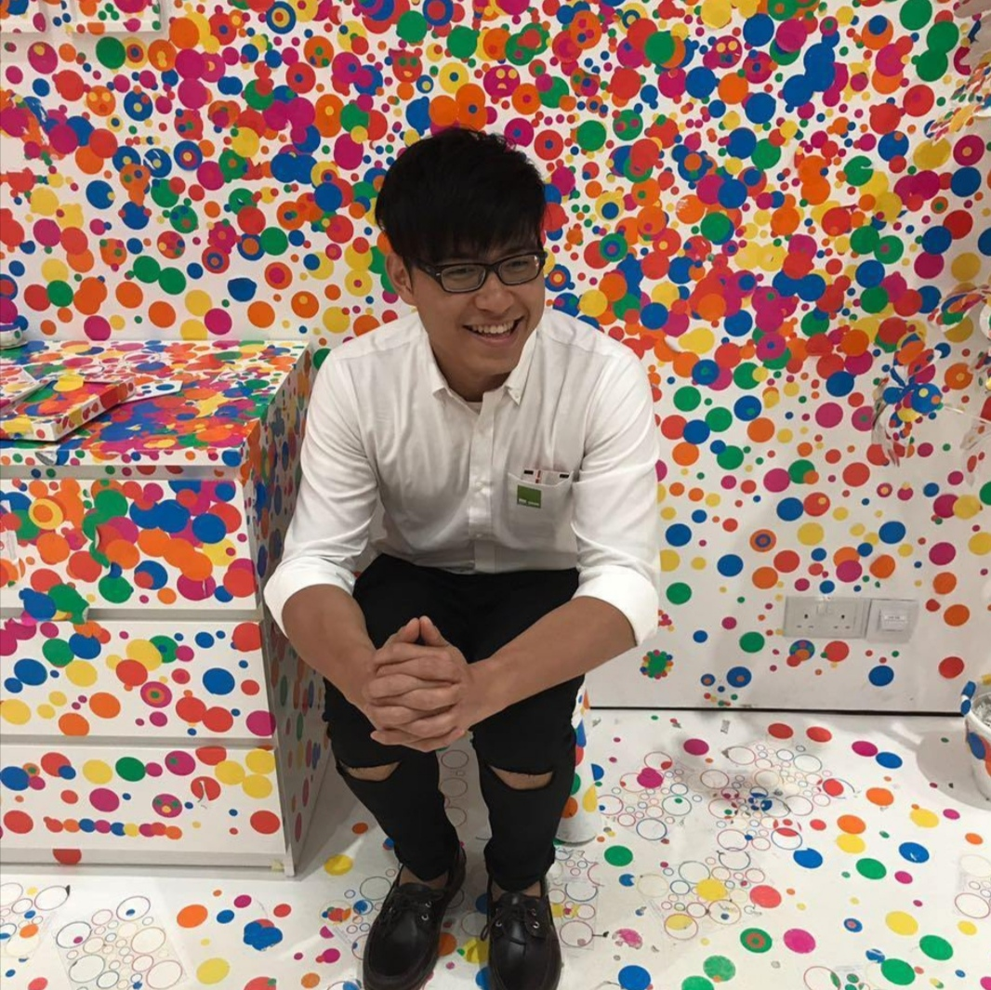

Introducing the team
Lee Kin Nam
Poon Wei Yuan
Koh Lay Hon (Jac)
Wesley Teo
Wong Yong Lin
Evelyn Yong

Slide 3
Executive Summary
Situation
Sentosa Development Corporation (SDC) is currently facing difficulties in meeting the demands of guests during peak period when there are large number of guests waiting for buses at the bus stops.
Complication
Currently, complimentary shuttle services are operated manually through radio dispatch by service captain with their counterparts. It will affect the reputation of Sentosa as a tourist attraction if people leave bad reviews about slow service and long waiting time.
Solution
To better manage the surge in number of guests at bus stops, we would like to recommend a dual approach :-
Adopting a machine learning model to help SDC to preempt the demand in ridership ahead to allow its Ops team to plan its bus scheduling to cater to the demand
Adding additional features in existing Sentosa App and installing digital signboards at bus stops will allow guests to view the bus arrival times so they can plan their activities accordingly without having to spend the time waiting for buses.
Impact
More dynamic scheduling ahead of demand surges.
Potential cost savings to remove under-utilised buses during non-peak hours.
Increase in customer satisfaction as they can better plan their time in Sentosa with knowledge of real time bus information through Sentosa App and Sentosa Ops team able to plan and deploy buses during ridership ahead.
Notes:
1) Predictive approach to deploying bus versus current fixed frequency approach
2) Cost savings – reducing bus frequency in off peak time to reduce under-utilized bus or having smaller capacity buses?
3) Improve customer experience for them to have real time bus information readily available to allow them to better plan their time so they can spend more time at attractions and amenities and less time waiting at bus stop.
4) Featuring it in Sentosa App will also increase chances of customer using the other features in the App (Attractions, F&B info and promotions, etc).
Optimise bus frequency through according to ridership demands during peak hours to better manage the surge in bus riders for x main reasons:
1. Route X has the highest demand in bus ridership
2. Popularity zones are mostly surrounded by
3. Top bus stops
4. Peak hours are
Reduce the average waiting time of buses at bus stops by X%, increase the overall customer satisfaction by X% with bus riders not missing more than a bus.

Slide 4
How might we provide better allocation of buses to routes/stops to cater for ridership demand?
Notes:
Thus, we frame the problem statement to "how might we provide better allocation of buses to routes/stopes to cater for ridership demands?"

Slide 5






Project Flow
Research, Analyse and Hypothesize
Data Processing
Exploratory Data Analysis
Feature Engineering
Machine Learning Modelling
Industry Research
Formulate the problem
Hypothesis Framing
Reading/cleaning of data
Replace/removal of null values
Merging of dataset
Understanding of data
Checking of relationship between variables
Visualising Data
Hypothesis testing
Feature selection
Create new features
Eliminate low variance features
Model Selection
Build and test model
Model prediction
Notes:
We apply a data driven approach to our solution wherein :-
1) Research, Formulate the problem and Hypothesize our problems/assumptions
2) Took the data provided and obtained from external to process the data
3) Analyse and obtain insights on the cleansed data
4) Select unique feature and creates new features
5) Build, test and train model to come up with a model that generates predictions with reasonably reliable predictions.

Slide 6
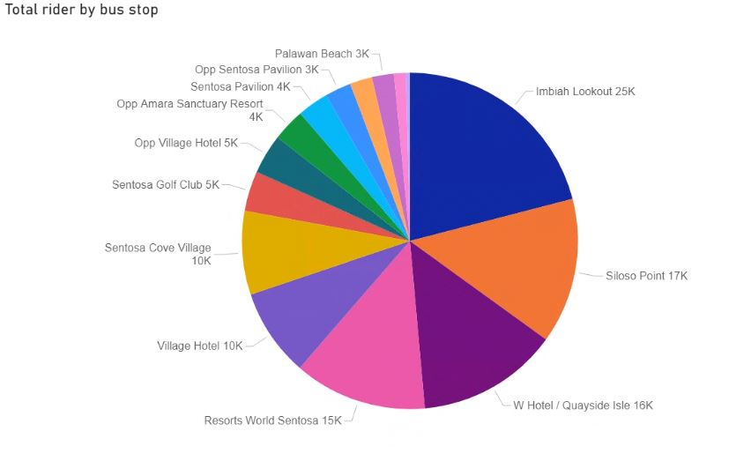
Total Ridership for Bus Stops
Exploratory Data Analysis
Imbiah lookout has the highest ridership of all bus stops.
__________________________
*Beach Station is excluded in this analysis as it is a bus interchange which naturally will have high ridership.
Our focus is on the bus stops between the interchange.
Source : 3 months actual ridership data (Jan to March 2021) from SDC
Notes:
Note: Analysing based average of total ridership

Slide 7
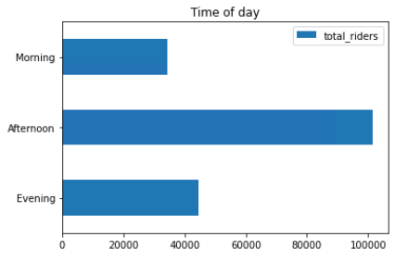
Ridership Peak Periods at all Bus Stops
Exploratory Data Analysis
Missing timeslot
Sentosa visitors generally prefer to take the bus in the afternoon compared to other times of the day.
This suggests that most of the bus congestion happens in the afternoon.
Source : 3 months actual ridership data (Jan to March 2021) from SDC
Notes:
Next we went to plot a graph from Jan to March to analyse the highest number of ridership at the time of the day.
We wanted to test our hypothesis if more visitors take the bus in the afternoon compared to other times of the day.
From this graph, we are able to tell that the peak period is in the afternoon is TRUE and congestion will usually happen in the afternoon.

Slide 8
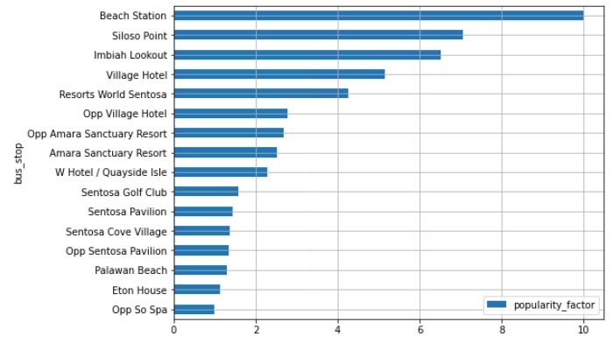
Exploratory Data Analysis
Imbiah Lookout is one of the top 3 popular bus stops
Source : 3 months actual ridership data (Jan to March 2021) from SDC
Imbiah Lookout and Siloso Point are the top bus stops with high popularity among all bus stops
The popularity factor has a correlation with the total rider. The higher the score, there will be more passengers.
Notes:
On the next slide, we will show you the popularity score for each bus stops.
By setting Attractions as the highest weightage to calcuate the popularity factor,
We can see that Imbiah Lookout is one of the top stations with high Popularity score. This means that the high total ridership is affected by the popularity factor.
--------------------------------------------------------------
The top 3 bus stops have similar results in Total Ridership for Bus Stops and Popularity Factor.
We can claim that the total ridership for bus stops has a correlation with Popularity factor.
The higher the Popularity Factor, the higher the total ridership for that bus stop.

Slide 9
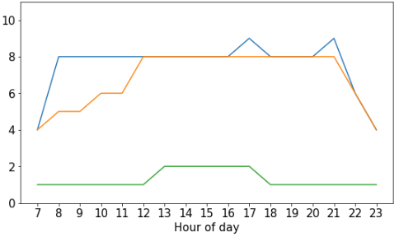
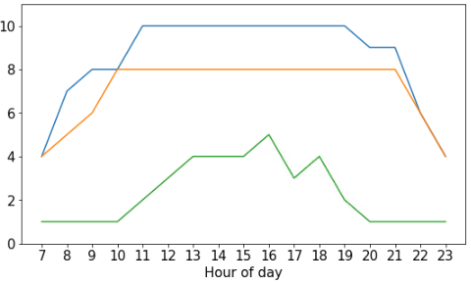
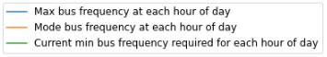
Bus Frequency of Imbiah Lookout
Exploratory Data Analysis
Next slide, we will visualize the trend of bus frequency at Imbiah Lookout.
These charts show the comparison at Imbiah lookout between the current hourly bus frequency and the min bus frequency
required to support the ridership based on a bus capacity of 50pax.
We plot the chart based on the Max, Mode, and Current bus frequency for each time of the day.
For example if we look only at the chart for weekdays, the current minimum required bus frequency at 12pm is ONE.
The score for this chart is calculated by grouping the sum of total ridership by all weekdays at 12pm in the dataset, divided by the bus capacity of 50pax.
After calculation,
The Green Line refers to the minimum value that appears in our dataset, which is ONE BUS at 12pm.
The Blue Line refers to the maximum value that appears in our dataset,
And the Orange Line refers to the value that appears most frequently in our dataset. which is EIGHT BUSES at 12pm.
For weekdays, the highest and also usual number of buses deployed to Imbiah is 8 buses, peaking at 9 buses during the 1700hours and 2100hours. the minimum number of buses required is between 1 to 2 buses per hour.
For our weekends+holidays chart, the highest number of buses deployed to Imbiah is 10 buses between 1100hours and 1900hours, with 8 buses being the usual number sent. The MINIMUM number of buses required ranges between 1 to 5 buses per hour.
You can also notice that the score is the lowest at 7am and 10pm and that is because Route C is not operating at that time too.
Based on the actual data from Jan to March throughout the hours for both charts, we can see that the Green Line deployed within each hour
is lower than the Max and Mode of the bus frequency.
This means that the actual bus deployment required to support the high ridership at Imbiah Lookout can be more than required.
There is a chance that buses are under utilized if they continue using the current fixed bus schedule to deploy at least 4 buses per hour.
There is also room for consideration for a reduction in bus frequency: especially before 1200hours and after 1800hours.
Weekdays
Weekends and holidays
Source : 3 months actual ridership data (Jan to March 2021) from SDC
Based on the highest ridership for every hour and taking the maximum bus capacity of 50pax, we identified that the actual bus deployment required to support the highest ridership could be more than required. There is a possibility of under-utilised buses using the current fixed bus schedule.
Notes:
These charts show the comparison at imbiah between the current hourly bus frequency and the min bus frequency required to support actual ridership based on a bus capacity of 50pax.
The blue line refer to the highest number of buses currently deployed in each hourly interval between jan to mar 2021, and the orange line refers to the number of buses usually deployed. The green line refers to the MINIMUM bus frequency required to support the current ridership at imbiah.
For weekdays, the highest and also usual number of buses deployed to imbiah is 8 buses, peaking at 9 buses during the 1700hours and 2100hours. the minimum number of buses required is between 1 to 2 buses per hour.
For weekends, the highest number of buses deployed to imbiah is 10 buses between 1100hours and 1900hours, with 8 buses being the usual number sent. The MINIMUM number of buses required ranges between 1 to 5 buses per hour.
Do note the dips at 0700hours and 2200hours onwards when route C is not operating.
Based on these figures, the actual frequency of buses deployed within each hour for Imbiah Lookout could be higher than required. It is possible that some buses are under-utilised in the current fixed schedule bus model. There is room for consideration for a reduction in bus frequency: especially before 1200hours and after 1800hours.
Having said that, SDC has to find the balance between maintaining customer expectations and cost optimization.

Slide 10
Feature Selection
Feature Engineering
Features
Internal Data (Provided by Sentosa)
External Data
Ridership Data
Holiday Flag (Govt Public Holidays, School Holidays)
Live Weather Data (weather.gov.sg)
Day of Week Flag
Weather Data
Rain Flag
Weekend Flag
Weekday Flag
Mid-week Flag
Saturday Flag
Sunday Flag
Weekday Holiday Flag
Weekend Holiday Flag
Notes:
For the purposes of training the model with exogenous variables, we created the following features:
Creating more features gives the model more detailed information which helps the model to give a more accurate prediction
Things to talk about in this slide:
Features created
Features selected

Slide 11
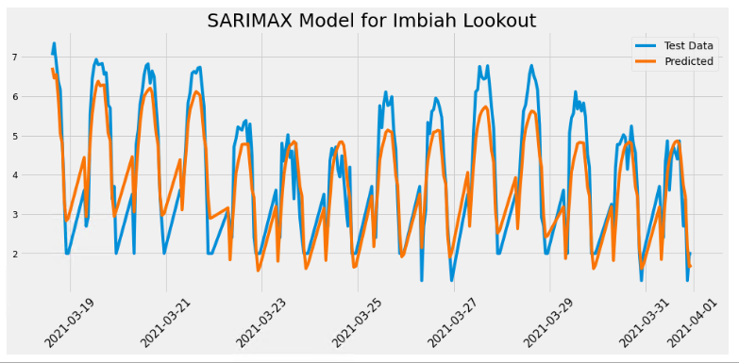
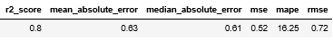
Machine Learning Modelling
Time Series Modelling (SARIMAX)
SARIMAX Model was applied to account for seasonal trends and exogenous factors such as rain, holidays and weekends.
R2 score and Mean Average Percentage Error (MAPE) to determine accuracy of our model
Source : 3 months actual ridership data (Jan to March 2021) from SDC
Notes:
How did we come up with the model?
1. Grouped riders by the operating hours of each day across the 3 months
2. Tested for stationarity
3. Performed data transformations – Log of dataset to scale, increased all values by 2 to shift dataset by a small number and remove zeroes
4. Split data into train/test (0.85 split)
5. Exogenous dataset (Weekend Flag, Holiday Flag, Rain Flag)
6. Run auto-arima to get best order and seasonal order
7. Run SARIMAX to train model
Given the chronological nature of our dataset and required prediction, we decided to go with a Time Series Model to predict future ridership. Specifically, we used SARIMAX to account for seasonal trends and exogenous factors such as rain, holidays and weekends. To get the best accuracy, we utilized auto-arima functions and looping to optimize the time series components and seasonal order. We then took the best result, which produced an R2 score of 0.8 and MAPE of 16.25%. We took these values to mean that our model was making accurate predictions, where the standard of R2 greater than 0.7 and MAPE value of less than 20% indicate a good result.
Things to talk about in this slide:
Which model we used and why
Results of our model, how and why we chose it

Slide 12
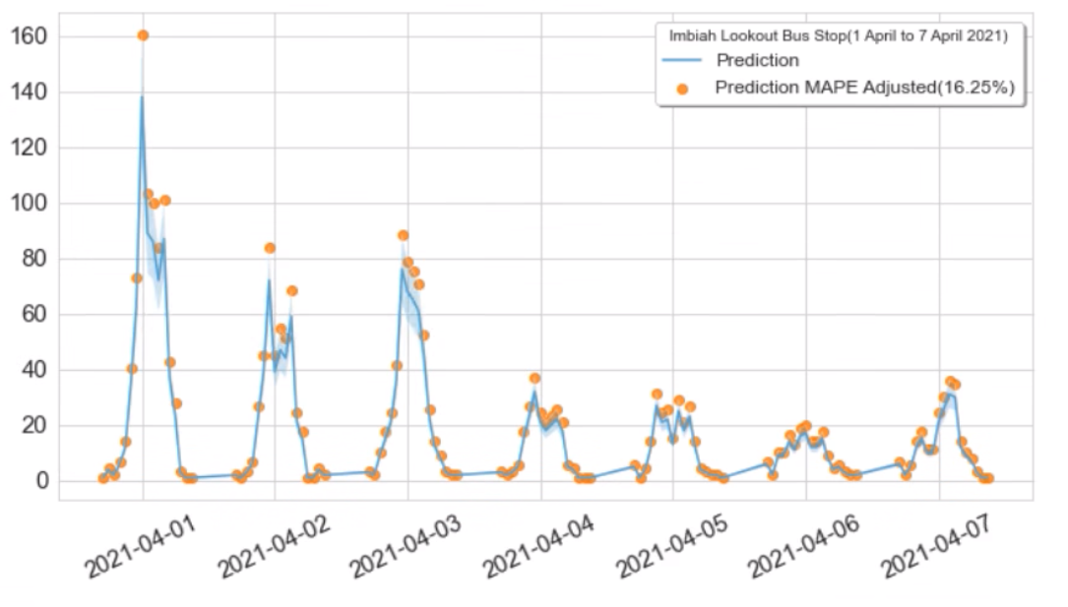
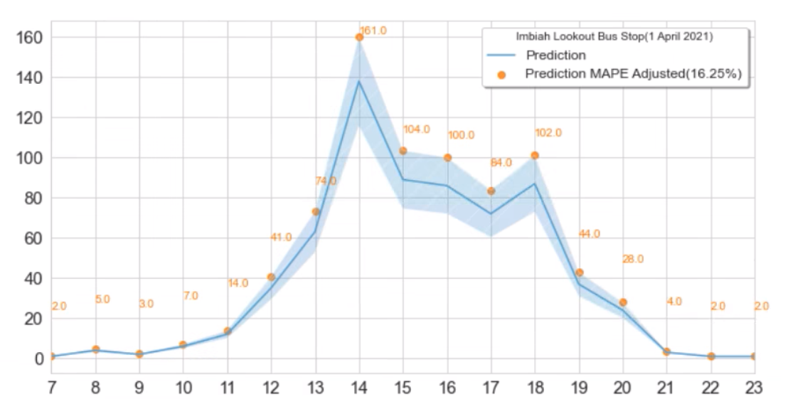
Ridership Predictions for 1st Week of April 2021
Machine Learning Modelling
Weekly Predictions
Hourly Prediction for 1 Day
Notes:
Following the creation of our model, we set out to predict ridership for the first 7 days of April, to cover the variations across the week which were featured in our model. To provide a buffer for error in our prediction we also provided a mape-adjusted prediction denoted by the light blue error band and orange points on the graph.
As seen in our prediction, similar trends and patterns are observed across the week, with high ridership starting on April 1st, a Thursday. Higher than average ridership continues to be predicted for April 2nd, which is a public holiday (Good Friday), and April 3rd which is a Saturday. This trend only begins to taper off on Sunday April 4th.
Zooming in to observe the hourly prediction by day, we see the same mid-day peaks that occur in the afternoon between the hours of two to six PM, with the most ridership of all hours being a prediction of 161 (after MAPE adjustment). This amount of demand would require a bus frequency of 4 buses to support, assuming a bus capacity of 50 persons. We will expand more on bus frequency in the next slide.
Things to talk about in this slide:
Explaining the components in the graphs in this slide (Prediction & Prediction+MAPE)
Analyzing the prediction and how it compares with the actual data
Zooming in on the hourly prediction and how it compares with actual data

Slide 13
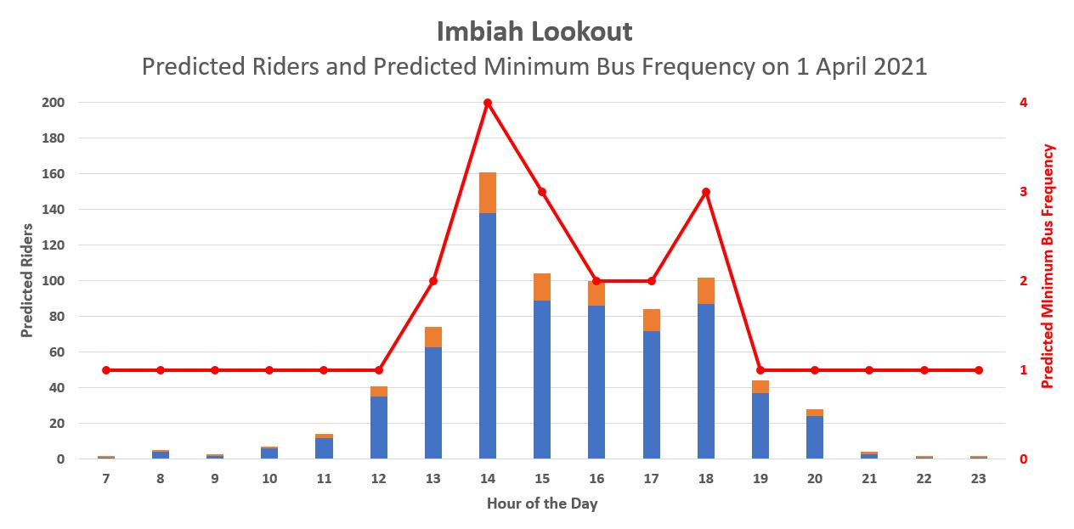
Predicted Minimum Bus Frequency Required on 1st April 2021
Actual bus frequency is not able to support the peaks in demand
Legend
Predicted
Ridership
Additional buffer of 16.25% according to MAPE Value in Prediction Model
Predicted Minimum Bus Frequency
Actual Bus Frequency (Derived from EDA)
Notes:
Building upon our ridership prediction of 1st April and using the 16.25% MAPE value as an additional buffer, we calculated the bus frequency based on the maximum bus capacity of 50pax.
We were then able to get the minimum required bus frequency as seen in the red line in the chart. We see a surge in demand at 2pm and 6pm where approximately 4 and 3 buses would be needed that hour respectively.
Comparing then our prediction of bus frequency with the actual bus frequency derived from our EDA, we see that the actual bus frequency would not be able to support the peaks in demand during certain hours of the day where ridership surges. This would lead to overcrowding and longer waiting times for the customers.
To that end, we propose that the usage of our prediction model would allow for a better allocation of buses to meet ridership demand in a dynamic manner as opposed to sending buses on a fixed frequency basis.
Additionally, we recognize that this only the first iteration of our model. With a structured data pipeline and extended training data over longer time periods, similar predictions can be made for other bus stops with higher model fidelity to further improve bus frequency.
Things to talk about in this slide:
The minimum bus frequency required for each hour based on ridership
How actual frequency differs from our prediction, and suggestions to improve bus frequency to meet peaks in demand
This is our phase 1 suggestion. With more data, similar predictions can be made for other bus stops to improve upon bus frequency

Slide 14
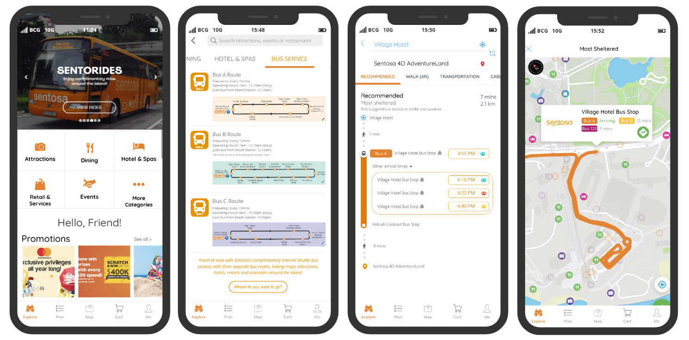
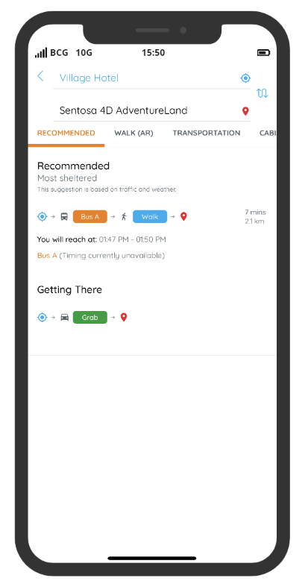
Adding features in existing Sentosa App Provide real time bus arrival and occupancy information
Addresses customer pain points in waiting for their buses.
Current Design
1
2
3
4
Notes:
Apart from the prediction model, we also notice there are missing features highlighting these complimentary shuttle buses. There are also limited information on the actual bus arrival time along with the available bus capacity as seen in the current design of the app. Our team came up with some wireframes on how we can improve on the design by adding new features to promote the shuttle buses and provide real time information readily available in google map/our data based. As seen in the 3rd wireframe, we aim to provide the actual bus arrival timings and overcrowding index to help visitors make informed decision in the planning of their routes. Digital signboards can also be placed at popular bus stops to indicate estimated arrival time and crowd information. The new features will help improve overall visitor satisfaction in Sentosa.
Add on features in the Apps:
1) Enhancement of Sentosa App – Arrival time missing, available capacity
2) Digital Signboard to be placed at popular bus stops to indicate estimated Arrival time and seating.

Slide 15


Our Recommendations
Bus Route
A bus prediction model to iterate ridership volume and hourly bus frequency to allow SDC Ops to allocate bus in a dynamic manner instead of the fixed frequency.
Bus stop
Sharing of real time bus information (Arrival time, available capacity) through:
Addition of new features in existing Sentosa App
Digital signboards at popular bus stops such as Imbah lookout
Predictive approach to deploy buses
Reduce operation costs for non-peak period
Improve visitor experience
Increase the number of users using the Sentosa App
Value & Impact
Notes:
To deploy the bus using the prediction model to allocate bus frequency in a dynamic manner instead of the fixed frequency so as to better manage operating costs and balance with ridership demand which in turn increase customer satisfaction.
1) Predictive approach to deploying bus versus current fixed frequency approach
2) Cost savings – reducing bus frequency in off peak time to reduce under-utilized bus (ideal bus frequency will be 2 - reduce visitor waiting frustration) or having smaller capacity buses?
3) Improve visitor experience for them to have real time bus information readily available to allow them to better plan their time or their routes. They can spend more time at attractions and amenities and less time waiting at bus stop.
4) Increase the number of users using the Sentosa App
- To reduce multiple applications open by the user for checking of bus route such as google map
- Increase awareness on the App - Featuring it in Sentosa App will also increase chances of customer using the other features in the App (Attractions, F&B info and promotions, etc).

Slide 16






Phase 1
Optimise Model
Phase 4
Phase 3
User Testing
Phase 2
Soft Launch
Build Prototype
Next steps
Time frame: 6 -9 months
Total rider coming in and out are the same number.
Priority in providing a good prediction model to optimise the bus frequency instead of focusing on business operations.
No key events or promotions during the period of data provided (Jan – Mar 2021) due to COVID-19 SMM measures.
Maximum bus capacity reduced from 88 to 50 pax due to COVID-19 SMM measures.
Time series model requires a longer time data (at least 1 year) in order to give more accurate predictions (current data is only 3 months).
Bus detection system unable to accurately detect actual count (Total In & Total Out does not match).
Bus stops and bus routes cannot be removed.
Baseline on customer satisfaction rating is unknown.
Key Assumptions
Limitations
Notes:
Phase 1:
- Run current model to get more data for fine tuning
Phase 2:
- Improve current app experience prototype and test with app users for 3 months
Phase 3:
- Get feedback on bus arrival prediction and improve on app
Phase 4:
- Launch of new features in app, market and promote.
Key Assumptions:
1) Total rider coming in and out are the same number.
2) Priority is on providing a good prediction model to optimise the bus frequency to bus stops (for customer satisfaction) instead of focusing on business operations
Limitations:
- 3 month data - the time series model requires a longer time data (preferably a year) in order to give more accurate predictions.
- Bus detection system – lack of accurate person to person scanning, don’t know actual in and out form scanner. No ticket issued.
- Bus stops and bus routes cannot be removed.
- No baseline on customer satisfaction rating
- Limited dataset due to COVID-19 situation, number of tourist dropped
- Not possible to measure customer satisfaction when there is no measurement involved.
(Provided by SDC: Our guest satisfaction is based on the overall experience on the island. Transportation/ accessibility may somewhat influenced the overall experience. These may include the wait time for the buses, whether pax are able to board the bus, and the convenience of getting around the island.)
Because of Covid-19 SMM measures there are no key events in Sentosa from Jan'21 to Mar'21. But typically, there will be promotion/ deals during the festive period and Mar School holidays.
Maximum capacity is 88 pax. But post CB period, we have capped it at 50 pax due to Safe Measurement Measures (SMM)
Suggestion for Q&A:
Improve on the passenger detection and counting system for better accuracy and reliability
- Compare analytics based on new predicted bus frequency vs
What other analytics we could do with more data:
List down additional analytics that could be done if more data were available. A good starting point could be by revisiting your assumptions or inferences made in situations where you did not have the exact data you needed
How we could operationalize:
Think about tangible next steps to execute the use-case
For example,
Validate assumptions
Map out limitations of data. Identify solutions to solve the limitations
Identify risks
Gauge impact on results/sensitivity analysis
Engage key stakeholders
Create detailed business plan
Submit proposal for approval
Etc.

Slide 17
Appendix

Slide 18
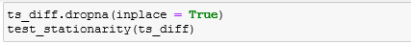
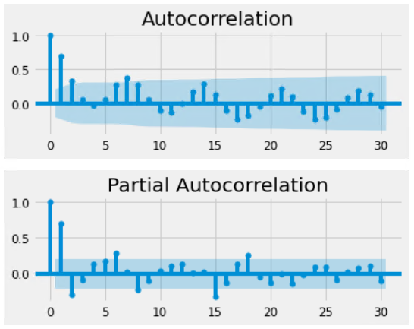
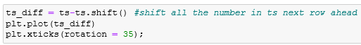
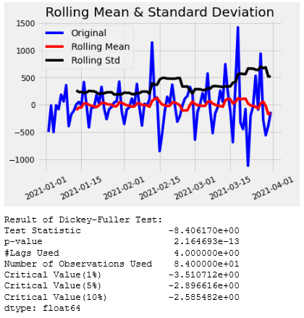
Modelling Appendix(Daily)
TS with Difference Technique & Stationarity Test
TS's ACF & PACF

Slide 19
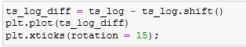
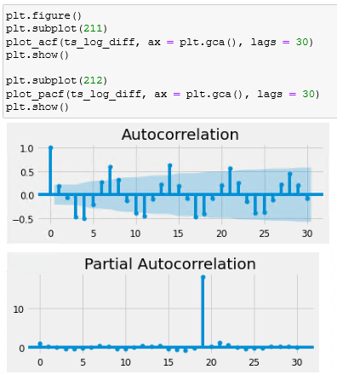
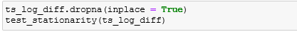
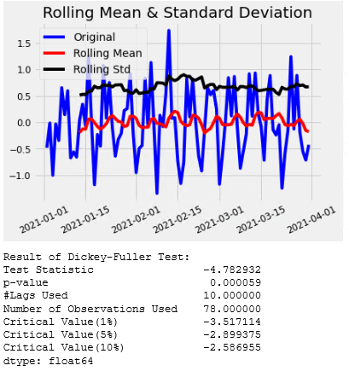
Modelling Appendix(Daily)
TS Log Transformed with Difference Technique & Stationarity Test
TS Log Diff's ACF & PACF

Slide 20
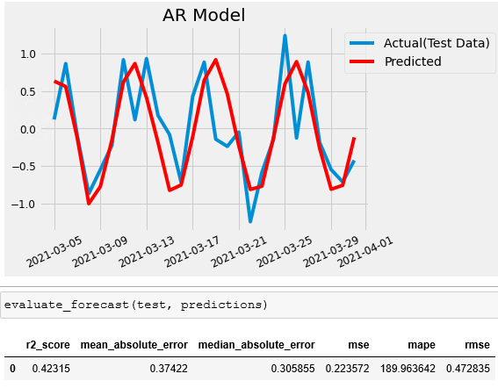
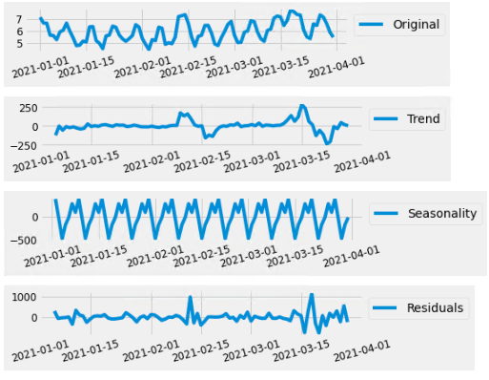
Modelling Appendix(Daily)
AR Model with TS Diff(No Exog Parameters)
TS Diff's ACF & PACF

Slide 21
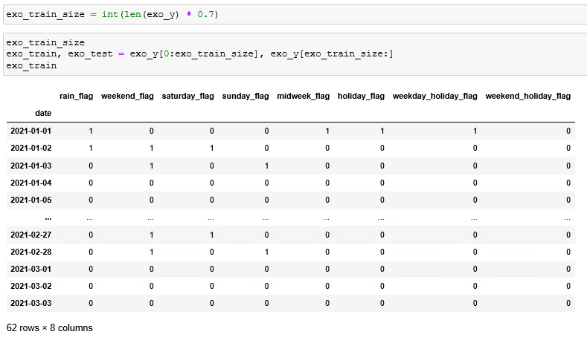
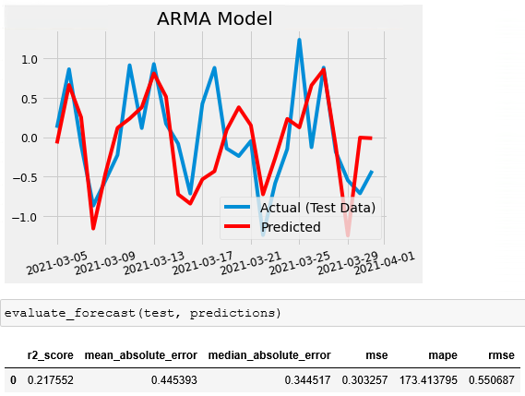
Modelling Appendix(Daily)
Exog Variables Tabular Format
ARMA Model with TS Diff(With Exog Parameters)

Slide 22
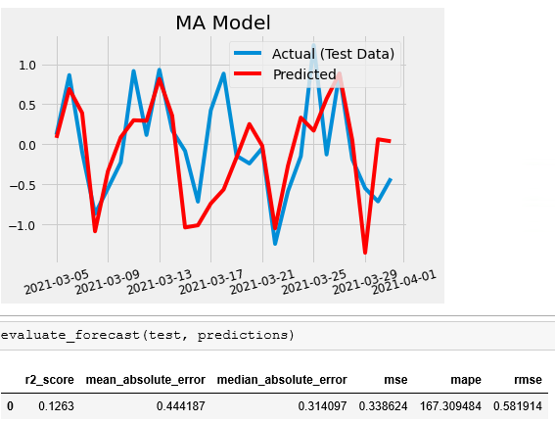
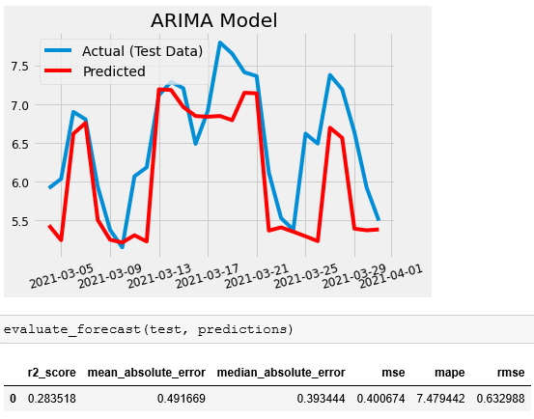
Modelling Appendix(Daily)
MA Model With TS Diff(With Exog Parameters)
ARIMA Model with TS Log(With Exog Parameters)

Slide 23
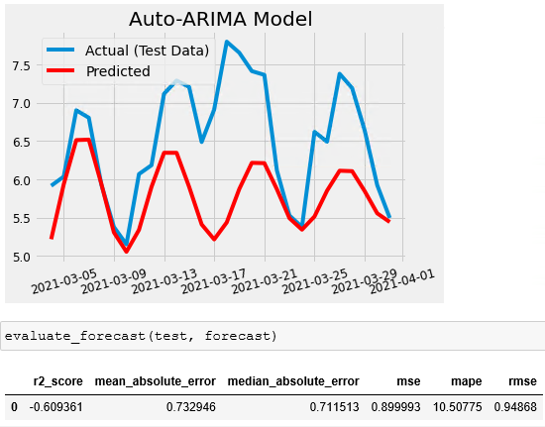
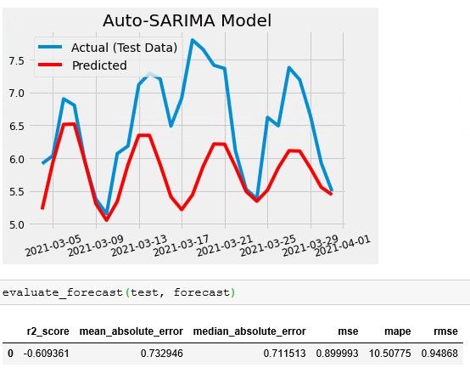
Modelling Appendix(Daily)
Auto Arima Model With TS Diff(With Exog Parameters)
Auto Sarima Model with TS Log(With Exog Parameters)

Slide 24
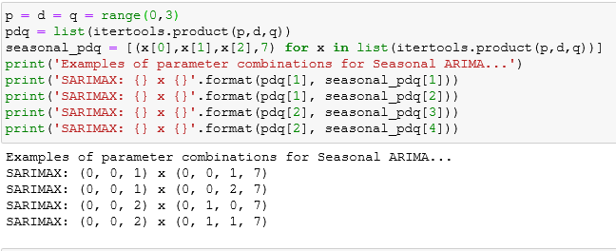
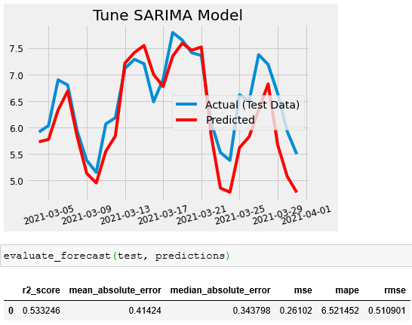
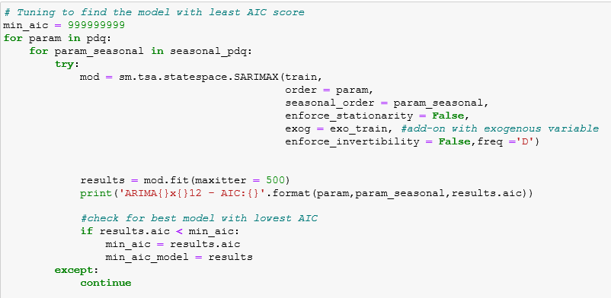
Modelling Appendix(Daily)
Example of Tune SARIMAX Model With Ts Log, Different Combination of PDQ, Seasonal PDQ(With Exog Parameters)
Tune Sarima Model with TS Log(With Exog Parameters)

Slide 25
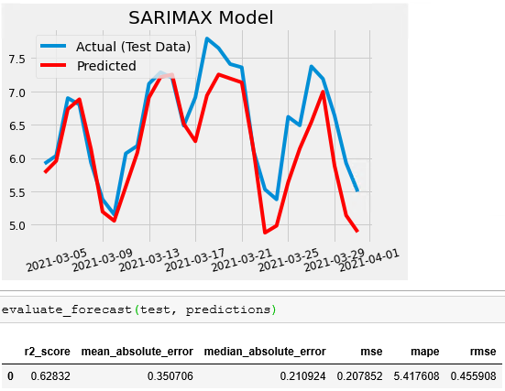
Modelling Appendix(Daily)
Sarimax Model with TS Log(With Exog Parameters)

Slide 26
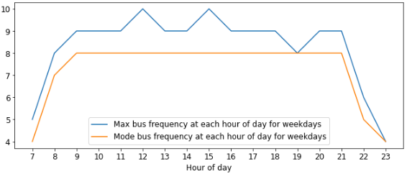
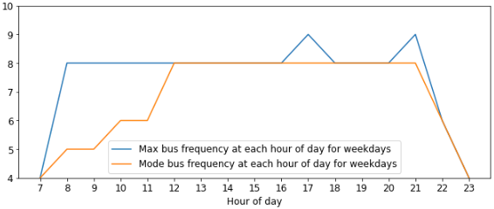
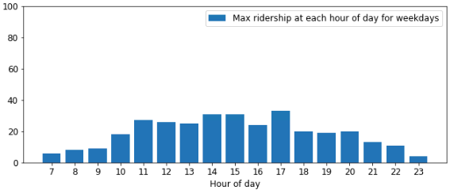
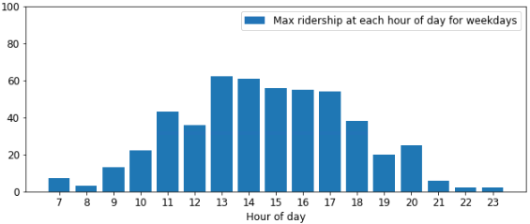
Bus Frequency of top bus stops Siloso Point and Imbiah Lookout (Weekday)
Exploratory Data Analysis
Siloso Point
Imbiah Lookout
Based on maximum bus ridership within each hour and bus capacity of 50, actual frequency of buses deployed within each hour on weekdays is higher than required.

Slide 27
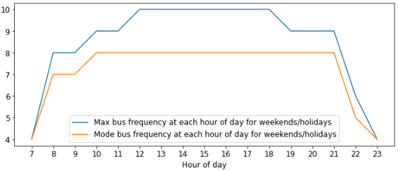
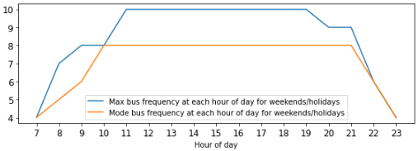
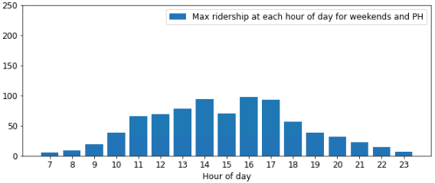
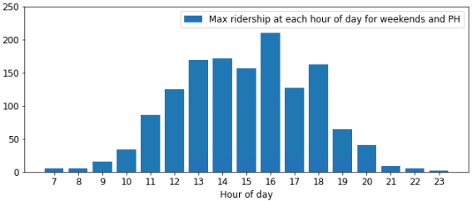
Bus Frequency of top bus stops Siloso Point and Imbiah Lookout (Weekend/holidays)
Exploratory Data Analysis
Siloso Point
Imbiah Lookout
Based on maximum bus ridership within each hour and bus capacity of 50, actual frequency of buses deployed within each hour on weekends is higher than required.

Slide 28
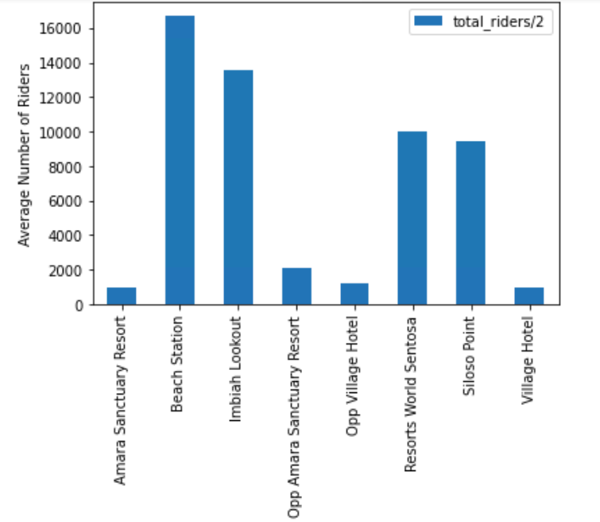
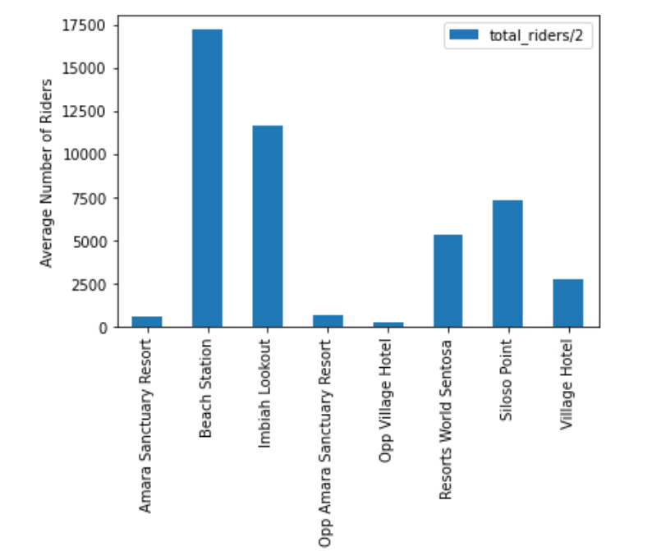
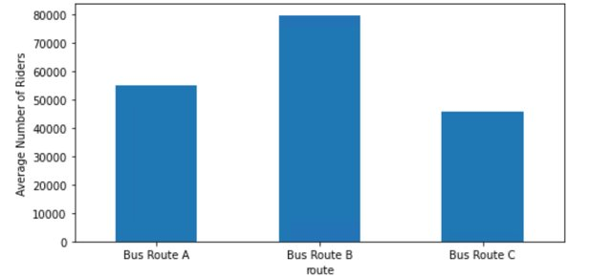
Exploratory Data Analysis
Imbiah Lookout and Siloso point are the top 2 most popular bus stops (ridership)
Bus Route A
Bus Route C
Route B has the highest ridership. However, Route A and C share the same routes but travel in the opposite direction. Hence, taking the combine ridership from Route A and C will be more accurate.

Slide 29
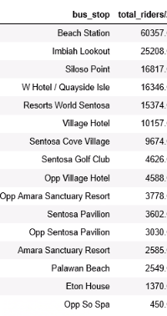
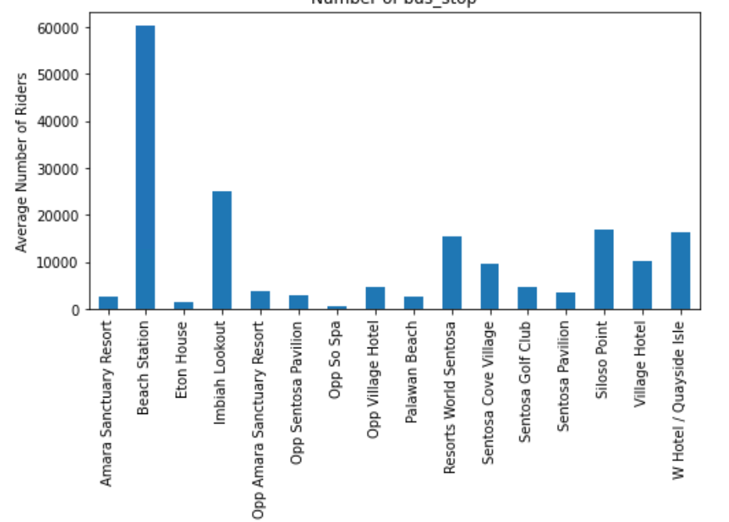
Total ridership for bus stops
Exploratory Data Analysis
Analysing average number of riders against bus stops
60,357
25,208
16,817
Pie chart – power BI – top 5 bus stops
(less Beach station)
Beach Station consists of Route A, B and C and is also the bus interchange.
Hence, we decided to focus on the top bus stop.

Slide 30
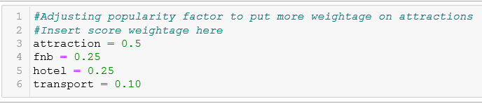

Calculation for Popularity Factor
The score for Popularity Factor is calculated with the following weightage.
We put Attraction as the highest percentage as we want to set our popularity factor based on guests more interested in Attractions compared to F&B and Hotels.

Slide 31

Hypothesis Testing for yes/no flags
Rain Flag p-value < 0.05
We reject H0 and accept H1, Ridership when is raining > Ridership when not raining
Insights: There is a significant correlation that total riders will increase when it is raining
Weekend Flag p-value < 0.05
We reject H0 and accept H1, Ridership during weekend > Ridership not during weekend
Insights: There is a significant correlation that total riders will increase during the weekend
Saturday flag pvalue < 0.05
We reject H0 and accept H1, Ridership during Saturday > Ridership not during Saturday
Insights: There is a significant correlation that total riders will increase when it is on Saturday
Sunday flag pvalue < 0.05
We reject H0 and accept H1, Ridership during Sunday > Ridership not during Sunday
Insights: There is a significant correlation that total riders will increase when it is on Sunday
midweek flag pvalue > 0.05
We accept H0, Ridership during midweek <= Ridership not during midweek
Insights: There is no correlation that total riders will increase during the midweek
Holiday flag pvalue < 0.05
We reject H0 and accept H1, Ridership during holiday > Ridership not during holiday
Insights: There is a significant correlation that total riders will increase when it is on a holiday
weekday holiday flag pvalue < 0.05
We reject H0 and accept H1, Ridership during weekday holiday > Ridership not during weekday holiday
Insights: There is a significant correlation that total riders will increase when it is on a holiday during the weekday
weekend holiday flag pvalue < 0.05
We reject H0 and accept H1, Ridership during weekend holiday > Ridership not during weekend holiday
Insights: There is a significant correlation that total riders will increase when it is on a holiday during the weekends

Slide 32


Modelling Appendix

Slide 33


Modelling Appendix

Slide 34

Modelling Appendix

Slide 35
Modelling Appendix

Slide 36

Modelling Appendix

Slide 37


Modelling Appendix

Slide 39
Appendix:
- Additional EDA Graphs (Hypothesis Testing)
- Additional Time Series model, including the variation of parameters

Slide 41

Our proposal...
Key assumptions
Limitations
- 3 month data - the time series model requires a longer time data (preferably a year) in order to give more accurate predictions.
- Bus scanners – lack of accurate person to person scanning, don’t know actual in and out form scanner. No ticket issued.
- Bus stops and bus routes cannot be removed.
- No baseline on customer satisfaction rating
- Limited dataset due to COVID-19 situation, number of tourist dropped
- Not possible to measure customer satisfaction when there is no measurement involved.
(Provided by SDC: Our guest satisfaction is based on the overall experience on the island. Transportation/ accessibility may somewhat influenced the overall experience. These may include the wait time for the buses, whether pax are able to board the bus, and the convenience of getting around the island.)
1) Total rider coming in and out are the same number.
2) Not to focus on optimising operations of the business but providing a good prediction model to improve the bus frequency of bus stops
3)Focus on providing a good prediction model to improve the bus frequency to bus stops instead of optimising on business operations

Slide 42
Where would we go next.. – ROAD MAP – PROJECT MILESTONES limitations – limited data Next steps - 1) Run on bigger data to fine tune 2) App – wireframe Sentosa App
How we could operationalize
What other analytics we could do with more data
Think about tangible next steps to execute the use-case
For example,
Validate assumptions
Map out limitations of data. Identify solutions to solve the limitations
Identify risks
Gauge impact on results/sensitivity analysis
Engage key stakeholders
Create detailed business plan
Submit proposal for approval
Etc.
List down additional analytics that could be done if more data were available. A good starting point could be by revisiting your assumptions or inferences made in situations where you did not have the exact data you needed

Slide 43

Buses can be made dynamic instead
of fixed frequency through out the day.
More buses deployed during peak periods
(noted to be in the afternoon)
And during weekends and holidays.
Based on our predictions,
we can see potentially there are
Under-utilised buses if
buses are running at 4 bus every hour.
Specific bus stops are in high demands
due to its high popularity factors.
Given it is not possible to close any bus stops or routes,
we focus on ridership demand of each bus stops so as to
focus on addressing the major pain points of reducing
Probability of overcrowding at bus stop so customers
are able to commute around Sentosa with our free
shuttle Buses seamlessly without long waiting times
at the bus stops.

Slide 44
KIV later after rest of basics are done
Bus frequency EDA (Actuals – support the predicted) = EDA + Modelling

Slide 45
Analytics deep dive: What analytics we did, what models we landed
Opportunity for the team to showcase the technical work done. Consider cutting and pasting some of the analytics itself with a short blurb clearly explaining the approach and outcomes
Feel free to add more such slides as needed
..
..
..

Slide 46
Provide real time bus arrival and occupancy information
Using real time information readily available in google map, provide bus arrival timings.
Provide overcrowding index.
1) Enhancement of Sentosa App – Arrival time missing, available capacity
2) Signboard at bus stops to indicate estimated Arrival time and seating.

Slide 47

Recommendation
Provide real time bus arrival and occupancy information
Using real time information readily available in google map, provide bus arrival timings.
Provide overcrowding index.
1) Enhancement of Sentosa App – Arrival time missing, available capacity
2) Signboard at bus stops to indicate estimated Arrival time and seating.
Addresses customer pain points in waiting for their buses.

Slide 48

Recommendation
Provide real time bus arrival and occupancy information
Using real time information readily available in google map, provide bus arrival timings.
Provide overcrowding index.
1) Enhancement of Sentosa App – Arrival time missing, available capacity
2) Signboard at bus stops to indicate estimated Arrival time and seating.
Addresses customer pain points in waiting for their buses.

Slide 49
Sentosa
What is the societal problem we chose?
is the population density of an area is higher than others where a lot of F&B establishments surrounding it
Popular Attractions near certain bus stops will directly affect the ridership
Events at a certain location will increase ridership to and from the location during the period of the event
Citizens suffering from
impact of problem
Why is it important?
By investigating the co-relationship in between above three points. We will know that some of the factors which contribute the population density in each bus-stop
What are the existing stop gaps that have failed?
Y M
~5% p.a
Asd
Citizens could
benefit
Incremental benefit per
citizen

Slide 50
<Automatic bus deployment system> could help reduce the crowded bus problem
Wy – TRANSPORT
What is the societal problem we chose?
•The peak period during opening/closing, lunch/ dinner, can cause a huge problem for transportation services in Sentosa.
•More people take the transport during these timing compared to regular timeslot during the whole day.
Citizens suffering from
impact of problem
Why is it important?
It will affect the reputation of Sentosa as a tourist attraction if people leave bad reviews about slow service
What are the existing stop gaps that have failed?
Y M
~5% p.a
•Currently the island ops team are managing bus operation manually by using radio to dispatch buses when crowds are increasing.
Citizens could
benefit
Incremental benefit per
citizen

Slide 51
We leveraged the power of data to analyze the root causes and drive valuable insights
Eve - Macro
…we identified that government restrictions reduces ridership to attractions by
By analyzing data from bus ridership to attractions before COVID & after COVID
X%
guests
Are impacted by the problem
Line/bar graph to show the number of travelers to Sentosa before and after COVID:
- the number of riders before COVID vs after COVID
Government restrictions due to COVID reduces ridership (Eg. Capacity of attractions reduce, booking for entry to attractions based on first come first serve basis)
..with following potential root cause by
Limited booking to attractions
Safe distancing measures
Xx
Xx
Xx
Xx

Slide 52

We had investigated the co-relationship in between population density, amenities , and resorts on each bus stop
KN
By analyzing data from the 'Population Density & Amenities' Vs 'Population Density & Resorts'
We found that, bus stops with more Amenities tend to be have higher population density than resort. Therefore, conclusion is number of amenities had a positive co-relationship with the population density in each bus stop.
Chart/Visual showing output or
key insights that build the output/recommendations
Limit to one insight/output theme per slide
..with following potential root causes
Bus stop with more Amenities like F&B tend to have higher ridership etc
Xx
Xx
Xx
Xx

Slide 53
Executive Summary
Situation
In recent years, we have met increasingly stiff competition on our hardware products, and with the pandemic, there is an explosion in using Video Conferencing Tools (VCT) for work and personal interactions. The total global revenue for VCT in 2019 was estimated to be 14 billion USD and projected to grow to 50 billion USD by 2026. (Global Market Insights Inc, 2020)
Currently, these shuttle services are operated manually through radio dispatch. This tends to be reactive in nature and may increase customer waiting time when surges in demand happens. Sentosa is looking for a solution to cater to higher ridership during peak period to increase visitor satisfaction and return.
Complication
We should expand our services by enhancing Facetime to enter the Global VCT market for all users for 3 main reasons:
Growing Demand for VCT
Acceleration in Remote Working
Growing Consumer Spending on Emerging Technology
We can provide Better Data Security and Privacy than our competitors
Facetime is secured by end-to-end encryption.
Data collection is the least among its competitors
We are the Top Brand in providing Seamless Experience
No.1 in brand value with focus in user experience
Strong in-house Ecosystem
Impact
We aim to capture 10% (USD 5 billion) of the VCT market by 2026 and attract non-Apple users to experience our services, and potentially getting them to buy our products.
Next Steps
With your approval, we can work with the R&D and marketing department on enhancing Facetime to enter the Global VCT market.

Slide 54


Pandemic is accelerating global demand for Remote connectivity services and moving Consumer spending towards Emerging Tech
Global acceleration towards working remotely by both employees and employers; Trend expected to continue post-pandemic
Consumer Tech Spend: Growing and moving away from Traditional towards Emerging Tech
Total consumer Tech spend est. 2.06 trillion USD by 2023. Consumer are embracing Emerging Tech such as Augmented Reality (AR) .
74% of respondents plan to
keep some remote work permanent post Covid
23%
Source : Garner April 2020
Source : IDC report
Notes:
Pandemic is accelerating global demand for remote connectivity services and moving Consumer spending towards Emerging Tech
In recent years when the whole world is living under the pandemic, Covid has catalyzed a perfect storm of events. Stay-at-home orders made home the center of everything and forced everything both work and leisure to be done digitally. This remote way of working has become a way of life for most and based on our analysis here, this trend is expected to continue after the pandemic ends.
A recent survey conducted in March 2020 by Gartner Inc with 317 Finance leaders worldwide asking them what percent of workforce that were not working remotely before Covid will remain working permanently remote after Covid. The survey results show 74% of respondents indicated they will move at least 5% of their previously on-site workforce to permanent remote positions after Covid. In fact, nearly a quarter (23%) said they will do that to least 20% of their on-site employees. This data is an example of the lasting impact the current coronavirus crisis will have on the way companies do business and how people like to continue to work and communicate going forward.
https://www.gartner.com/en/newsroom/press-releases/2020-04-03-gartner-cfo-surey-reveals-74-percent-of-organizations-to-shift-some-employees-to-remote-work-permanently2
Another trend worth noting is:
Consumer technology spend is expected to reach USD 2.06 trillion by 2023.
Although Traditional technology is expected to grow, it has reached a plateau and is growing at only a 5-year CAGR of 2% as compared to the Emerging technology which is growing at a 5-year CAGR of 13% that is about 6 times of Traditional tech.
The Augmented Reality (AR) technology which is one of our company strengths is an Emerging Technology that is in a favorable position to ride this upward spend.
Thus, we see an opportunity to make use of our expertise in AR to enhance Facetime into a global VCT tool for all users to capture these growing demands beyond the pandemic.
Note:
Traditional - personal computing devices, mobile phones and mobile telecom - more recent years, advancements in hardware are mostly about slightly faster processors, more storage, better camera or better battery life.
Emerging - AR/VR headsets, drones, robotic systems, smart home devices, and wearables
1 http://www3.weforum.org/docs/WEF_Future_of_Jobs_2020.pdf
2 https://www.channelasia.tech/article/672259/hardware-software-services-how-covid-19-impacting-asian-tech-spend/
3https://www.techrepublic.com/article/consumer-tech-spending-to-top-2-trillion-by-2023-thanks-to-smart-home-devices-and-on-demand-services/

Slide 55


Strong trust in our Brand, Data Security, Privacy and high appreciation of our ecosystem in the consumer market
Data Security
#1 Brand Value and User Experience
Facetime provides end-to-end encryption for all users. Zoom provides end-to-end encryption only for its paid users.
Rank | Brand | Value (billion USD)
1 | Apple | 352.21
2 | Microsoft | 326.54
3 | Google | 323.60
4 | Tencent | 150.98
5 | Facebook | 147.19
Data Privacy
Source: BCG analysis : Brandz – Top 100 most valuable global brands 2020
Strong in-house Ecosystem
Seamless integration and optimization between various network of devices, software and services.
Source: Strategic Management Insight
Source: The Data Big Tech Companies Have On You
Notes:
Another 2 reasons we should enhancing Facetime to enter the Global VCT is
1) we can provide better data security n privacy
and
2) we are the Top brand in providing seamless experience
First, let’s discuss about data security n privacy.
In term of Data Security,
Facetime and VCT market leader (Zoom) is using end-2-end encryption
Facetime is free for all, while Zoom provide end-to-end encryption only for paid user.
This means, if you’re Zoom’s free user, that your data has potential risk for unauthorized access.
In term of Data Privacy,
Chart here show we collect least data on its users as compares to its major tech competitors. We collect MINIMUM data to improve products, services, content.
Most importantly, we DO NOT share personal info with third parties for marketing purpose.
Next, let’s move to next topic of Top brand in providing seamless experience
Apple products and services are perceived to be better off.
In 2020, we r #1 most valuable tech company.
Besides, we have Strong in-house Ecosystem to seamlessly integrate and optimize between devices, applications, software and service.
In summary, we would like to recommend to enhance Facetime to enter global-VCT market. Because of growing demand, our strengths in data security n privacy and top brand in providing seamless experience.
With this, we are now welcome for any questions.

Slide 56
Solving <this problem> could impact Y M lives across B countries
Problem faced by Sentosa
Develop a solution to enable effective allocation of bus schedule based on demand
Guests suffering from
impact of problem
Why is it important?
Demands of guests during peak periods not met, and inefficient use of resources during off-peak periods
What are the existing stop gaps that have failed?
Y M
~5% p.a
Manual management of bus operation – radio over counterparts to dispatch buses to meet demand
Guests could
benefit
Incremental benefit per
guest

Slide 57
We leveraged the power of data to analyze the root causes and drive valuable insights
By analyzing data from <supermarket, bank..>
…we identified <describe scale of problem>..
…we identified <describe scale of problem>..
Chart/Visual showing output or
key insights that build the output/recommendations
Limit to one insight/output theme per slide
Z M citizens
Are impacted by the problem
..with following potential root causes
Xx
Xx
Xx
Xx
Xx

Slide 58



We leveraged the power of data to analyze the root causes and drive valuable insights
Wy – TRANSPORT
By analyzing data from <supermarket, bank..>
…we identified <describe scale of problem>..
…we identified <describe scale of problem>..
Chart/Visual showing output or
key insights that build the output/recommendations
Limit to one insight/output theme per slide
Z M citizens
Are impacted by the problem
..with following potential root causes
The number of passengers boarding this bus route is 35% more in the morning compare to afternoon.
The bus occupancy rate at this stop(xx stop) is the highest among the entire bus route.
This bus route (Bus A Route) has 26% more passengers compared to Bus route B and C throughout the whole week.

Slide 59
We leveraged the power of data to analyze the root causes and drive valuable insights
YL - Rain
By analyzing Weather data from Sentosa over the period of Jan – Mar 2021...
…we identified <there is an increase in number of guests getting on buses when there is (x amount of) rain>..
Chart/Visual showing output or
key insights that build the output/recommendations
Limit to one insight/output theme per slide
Line graph to show the number of guests getting on buses (toward exit direction) corresponding to whether it is raining/amount of rain
X guests
Are impacted by the problem
..with following potential root causes
When there is rain, guests would want to move on buses from point to point
When there is heavy lasting rain, guests will choose to leave Sentosa
Xx
Xx
Xx

Slide 60
We leveraged the power of data to analyze the root causes and drive valuable insights
YL - Hot Weather
By analyzing Weather data from Sentosa over the period of Jan – Mar 2021...
…we identified <there is an increase in number of guests getting on buses when temperature > >32degrees>..
Chart/Visual showing output or
key insights that build the output/recommendations
Limit to one insight/output theme per slide
Line graph to show the number of guests getting on buses corresponding to temperature
X guests
Are impacted by the problem
..with following potential root causes
Hot weather will result in guests choosing to ride bus between points instead of walking
Guests will seek shade during hot weather
Xx
Xx
Xx

Slide 61
We leveraged the power of data to analyze the root causes and drive valuable insights
Eve - Customer
By analyzing data from hotels around Sentosa, bus ridership & dispatch numbers at bus stops near hotels
…we identified that the hotel check-in/out time influence
X%
hotel guests
Scatter chart to show correlation between:
- the number of hotel guests per day
- the number of riders near hotel bus stops per day
- the number of buses requested by radio dispatch per day
To find if the peak time at these bus stops is due to the hotels check-in/out time.
Recommend to increase number of buses at bus stops near hotels to meet demand.
Are impacted by the problem
..with following potential root cause by
Increase in hotel guests with luggages at bus stops near hotels during check-in/out time (to identify exact time)
Xx
Xx
Xx
Xx

Slide 62
Wy- transport
Based on our analysis, we propose..
Y M Citizens
Recommendations/Solution
Automatic Bus Deployment Schedule System
Could benefit..
How does it work?
•Predictive Model using historical data to know the highest volume of customers taking the shuttle bus
Each day per week and the time of the day.
•Reading 4-day weather forecast from weather.gov.sg to adjust the bus frequency every Monday/Friday
How is it different compared to the existing stop gaps?
Currently using radios is dispatch drivers manually when crowded but with this system.
We will automatically print a predicted schedule for deploying bus drivers per week.
5%
Per citizen
By <incremental benefit> per year
Key assumptions
Layout key assumptions made while building the solution/recommendation
The frequency of passengers taking the bus shutter service remains the same every week unless there is a public holiday.
There are no traffic accidents which will disrupt the bus routes
Predicted Weather forecast is accurate and do not change on the actual day.
4 Years
Over the next 4 years..

Slide 63
Eve - Customer
Based on our analysis, we propose..
Y M Citizens
Could benefit..
Recommendations/Solution
Describe the model or solution that the team has created. Include only relevant details such as :
How does it work? - Predictive model to increase bus demand during hotel check-in/out timings
How is it different compared to the existing stop gaps? - Reduce in manual radio dispatch for more buses at hotel bus stops
If it is a recommendation driven by insights obtained, list the recommendations out. Use simple, clear language
5%
Per citizen
By <incremental benefit> per year
Key assumptions
Layout key assumptions made while building the solution/recommendation
4 Years
Over the next 4 years..

